Slide 1
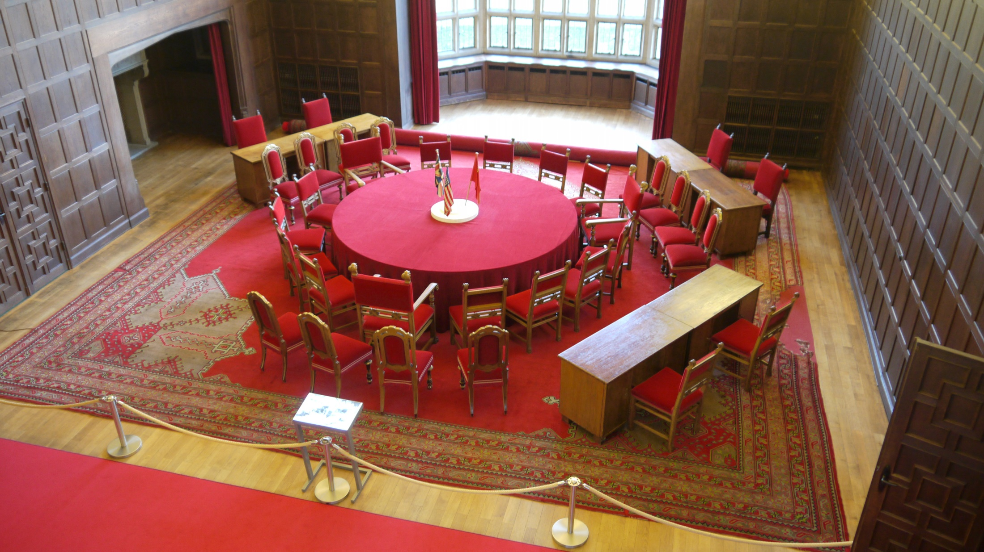
The Hall of Fame

Slide 2
Your task
Create your own Hall of Fame for key Cold War figures
Each leader will have an electronic display with information about them, as well as links to video clips, images, web pages and so on

Slide 3
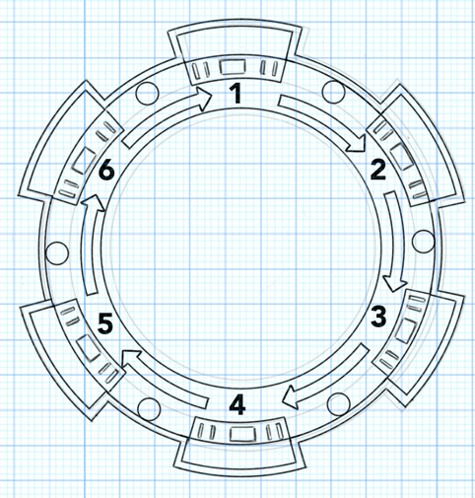
Your task
Unlike the room on slide 1, which was used for the Potsdam Conference), your Hall of Fame only has six seats, so you must first decide which leaders to allow in:
Winston Churchill (UK)
Franklin D Roosevelt (USA)
Josef Stalin (USSR)
Harry Truman (USA)
Nikita Khrushchev (USSR)
Dwight Eisenhower (USA)
John F Kennedy (USA)
Next you need to research each leader and create a profile for each of them
Notes:
3

Slide 4
Cold War Leaders 1945-65 Hall of Fame:
Who was he?
What did he do?
[Place an image here from the resource or a copyright-free internet image]
Why did his actions matter?
Why did take the actions he took?
FIND OUT MORE
[Put links to movie clips, sound files or any other resources which you think are useful.]
[Put your website(s) here. Make sure you say why each site will be useful. And why is it a trustworthy site?]

Slide 5
Cold War Leaders 1945-65 Hall of Fame:
Who was he?
What did he do?
[Place an image here from the resource or a copyright-free internet image]
Why did his actions matter?
Why did take the actions he took?
FIND OUT MORE
[Put links to movie clips, sound files or any other resources which you think are useful.]
[Put your website(s) here. Make sure you say why each site will be useful. And why is it a trustworthy site?]

Slide 6
Cold War Leaders 1945-65 Hall of Fame:
Who was he?
What did he do?
[Place an image here from the resource or a copyright-free internet image]
Why did his actions matter?
Why did take the actions he took?
FIND OUT MORE
[Put links to movie clips, sound files or any other resources which you think are useful.]
[Put your website(s) here. Make sure you say why each site will be useful. And why is it a trustworthy site?]

Slide 7
Cold War Leaders 1945-65 Hall of Fame:
Who was he?
What did he do?
[Place an image here from the resource or a copyright-free internet image]
Why did his actions matter?
Why did take the actions he took?
FIND OUT MORE
[Put links to movie clips, sound files or any other resources which you think are useful.]
[Put your website(s) here. Make sure you say why each site will be useful. And why is it a trustworthy site?]

Slide 8
Cold War Leaders 1945-65 Hall of Fame:
Who was he?
What did he do?
[Place an image here from the resource or a copyright-free internet image]
Why did his actions matter?
Why did take the actions he took?
FIND OUT MORE
[Put links to movie clips, sound files or any other resources which you think are useful.]
[Put your website(s) here. Make sure you say why each site will be useful. And why is it a trustworthy site?]

Slide 9
Cold War Leaders 1945-65 Hall of Fame:
Who was he?
What did he do?
[Place an image here from the resource or a copyright-free internet image]
Why did his actions matter?
Why did take the actions he took?
FIND OUT MORE
[Put links to movie clips, sound files or any other resources which you think are useful.]
[Put your website(s) here. Make sure you say why each site will be useful. And why is it a trustworthy site?]

Slide 10
Who gets pride of place?
There will be two entrances to the Hall of Fame. This means that the most prestigious spot is number 1.
Who would you give this honour to and why?
Edit the diagram and decide which leader will sit where.
1
6
2
5
3
4
Entrance
Entrance

